Slide 1
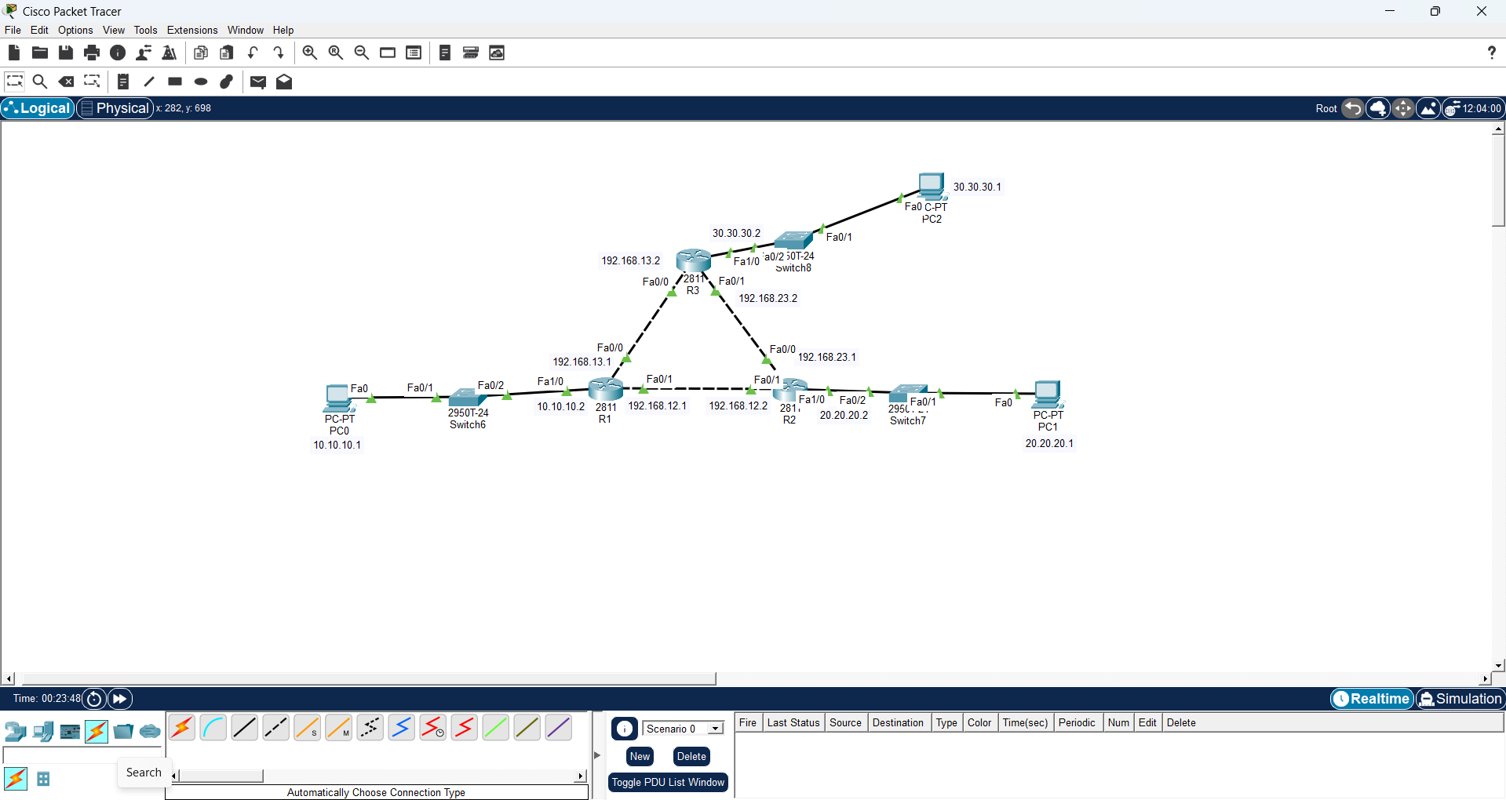
Setting up the Network

Slide 2
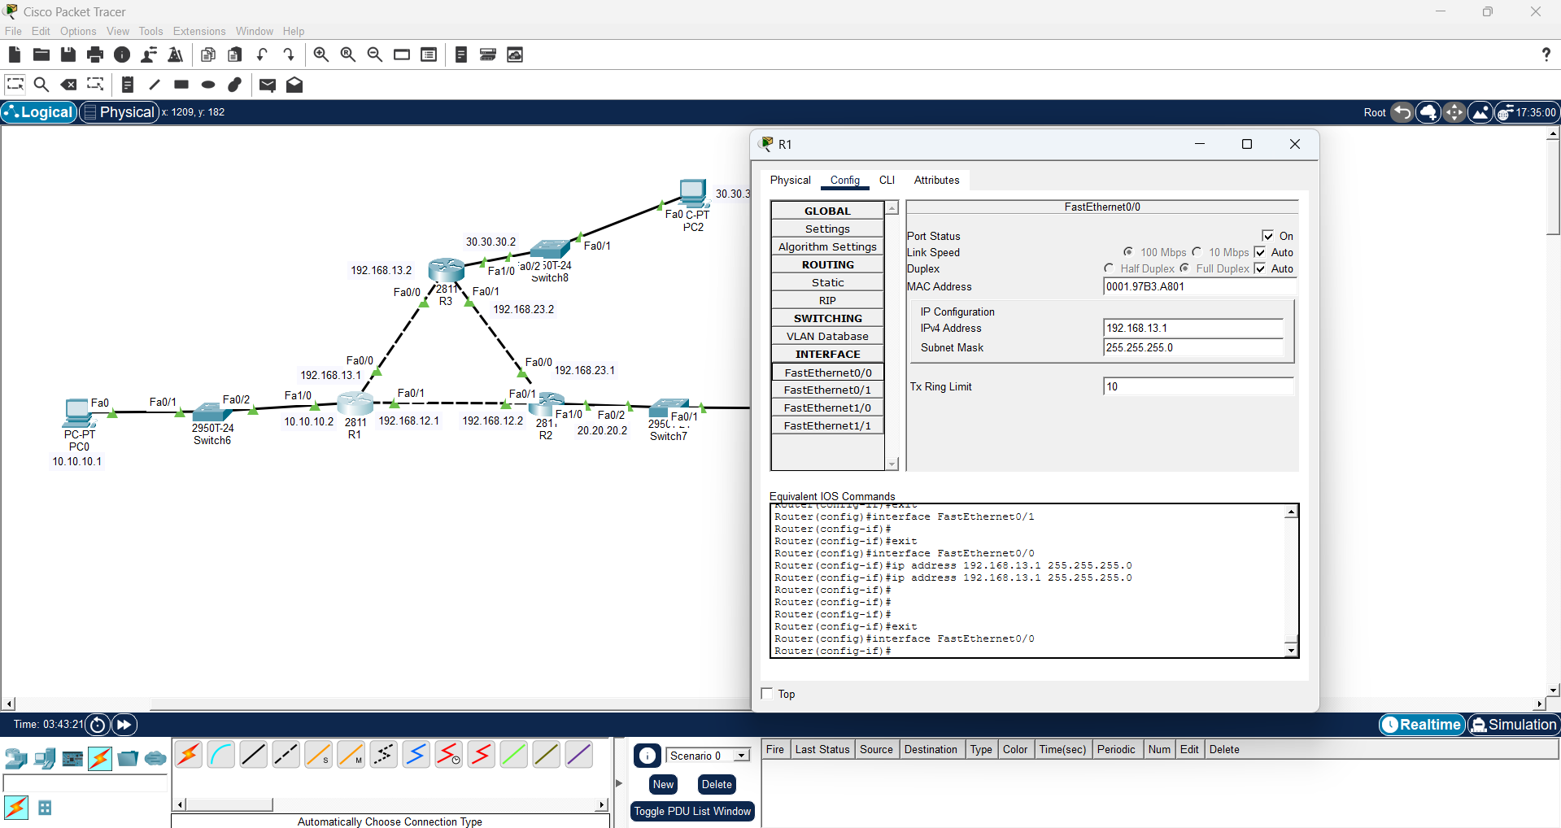
Inputting wrong wildcard mask

Slide 3
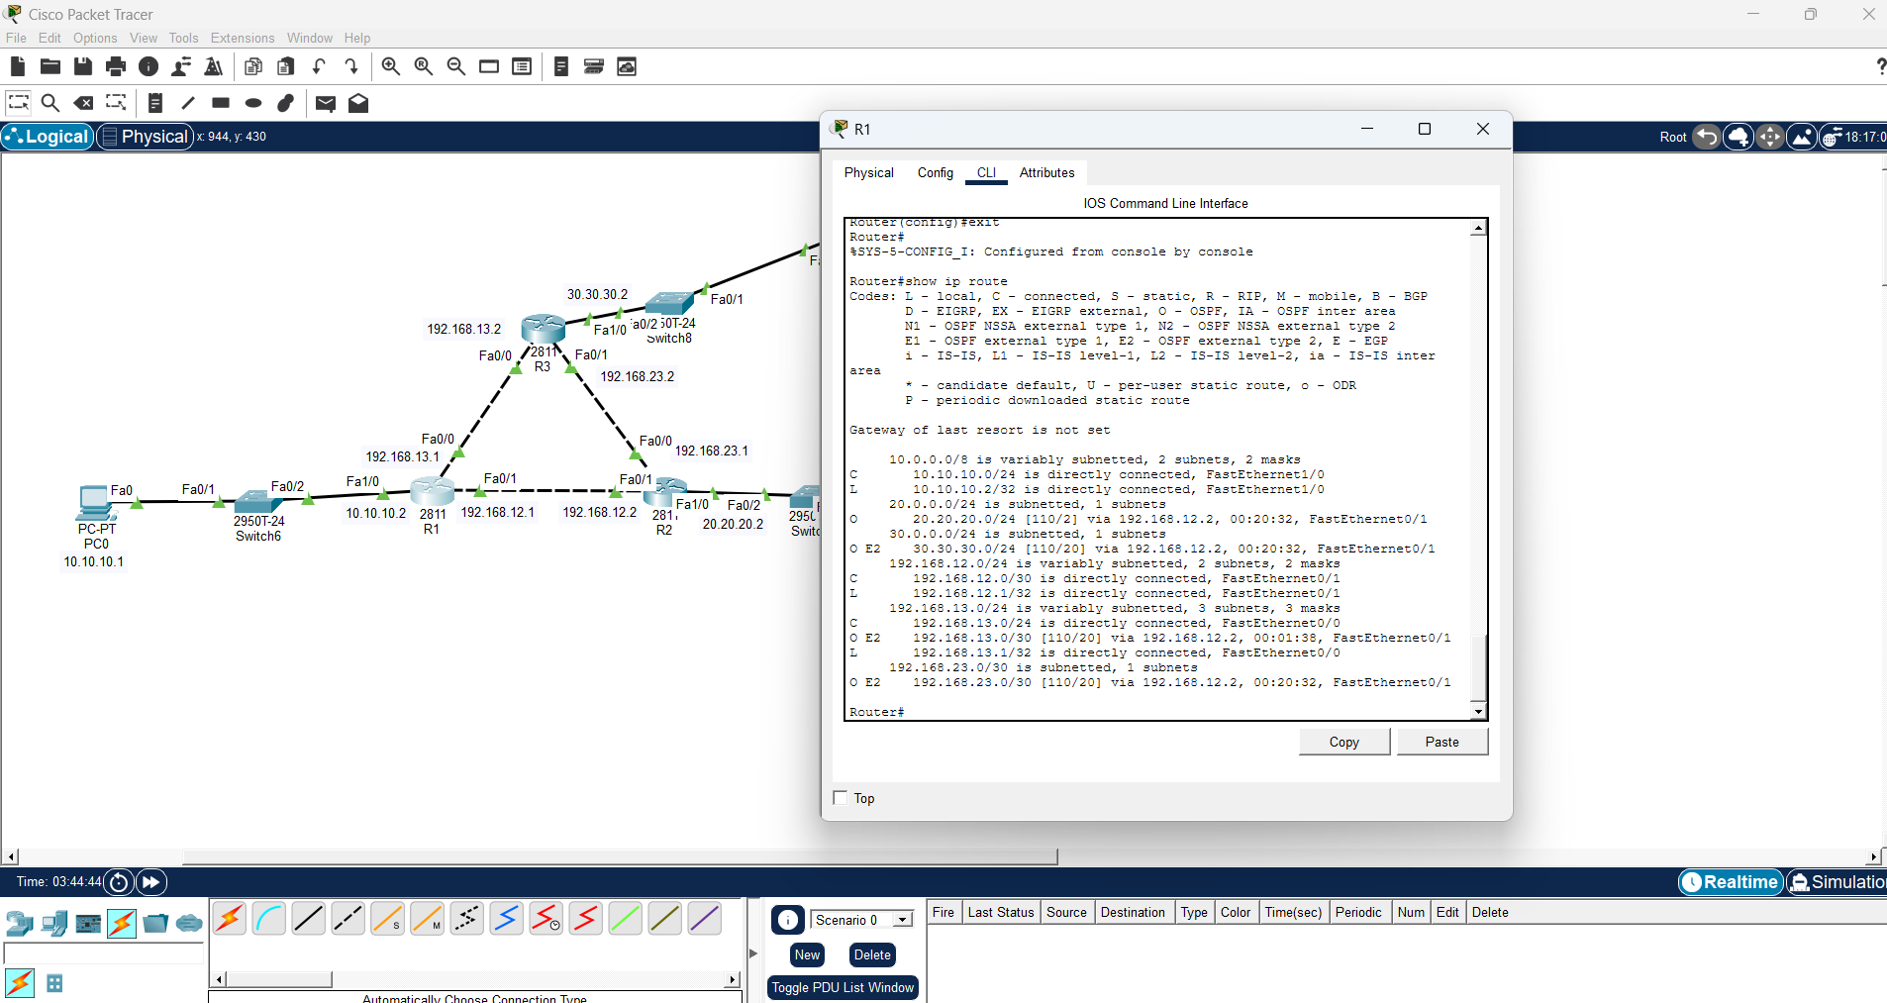
Connection not seen in ip route

Slide 4
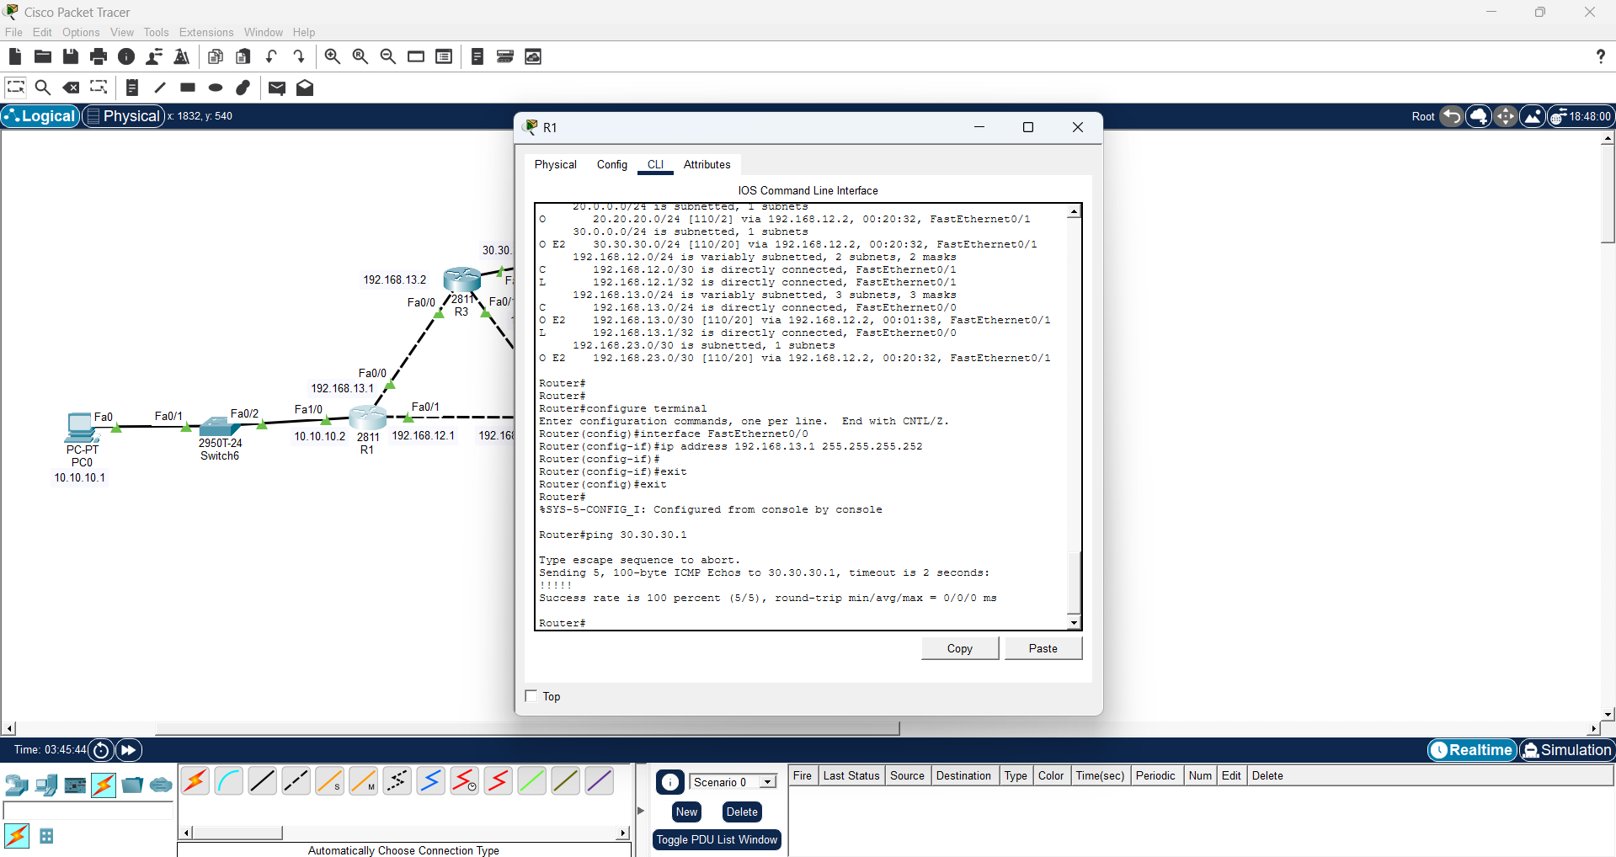
Ping to 30.30.30.1 successful

Slide 5
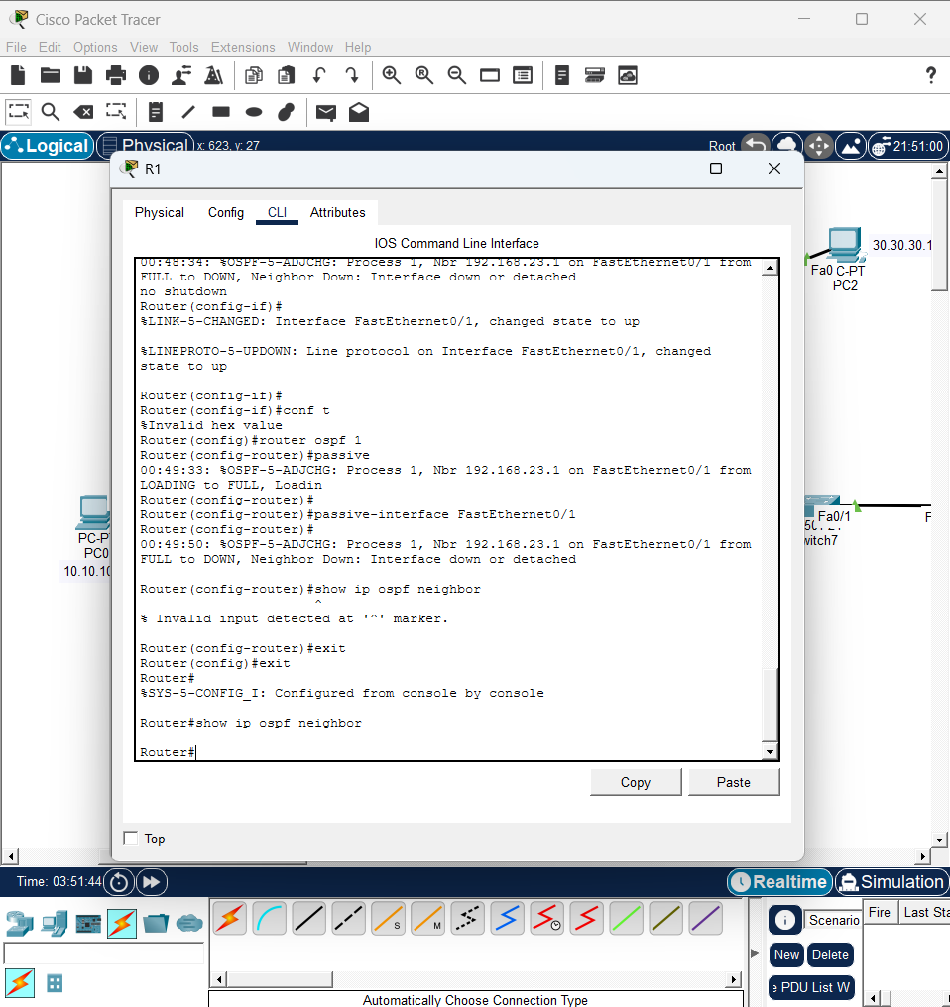
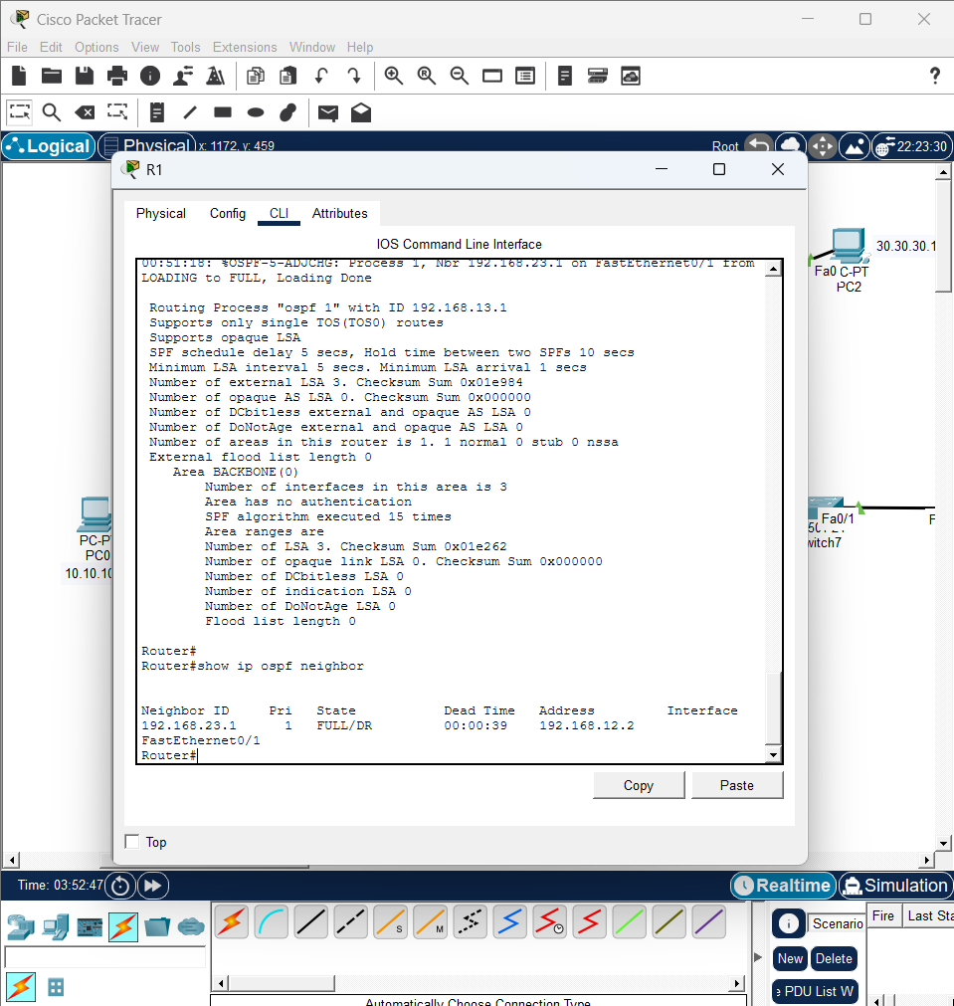
Passive interface

Slide 6
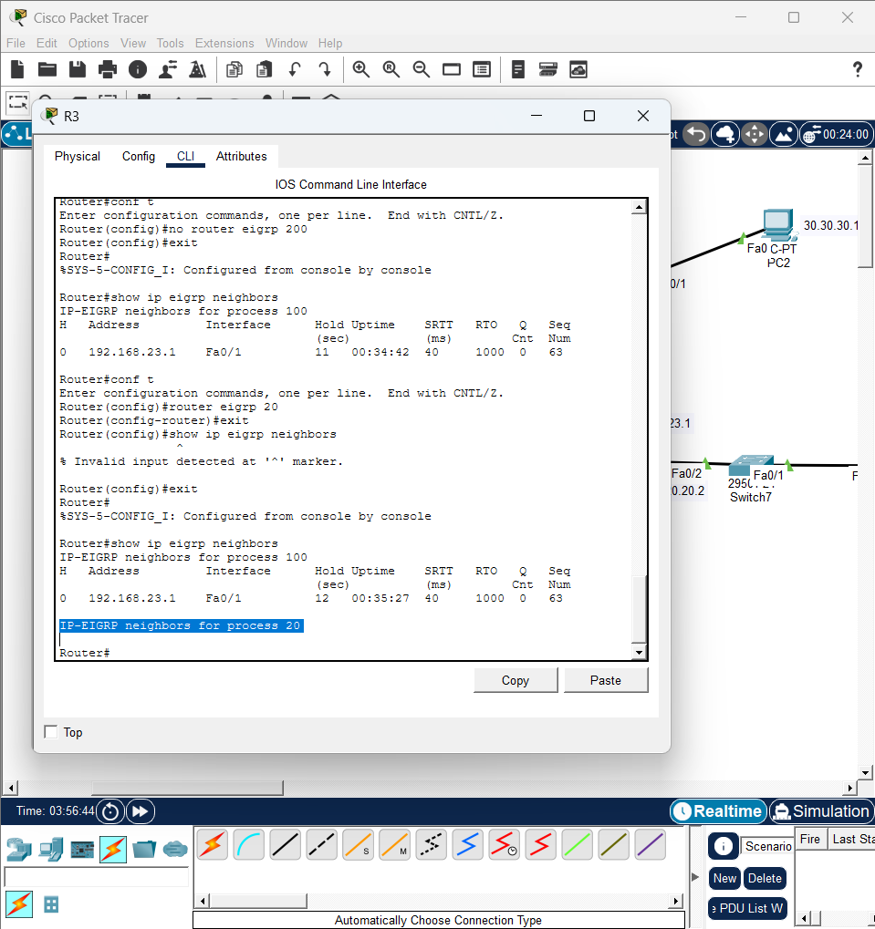
Wrong Autonomous System

Slide 7
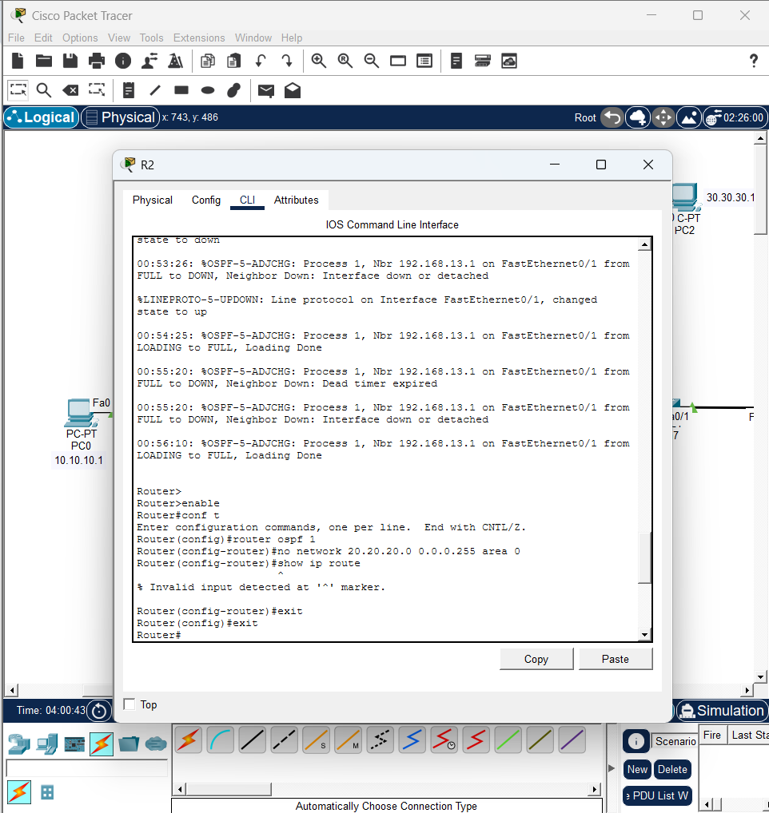
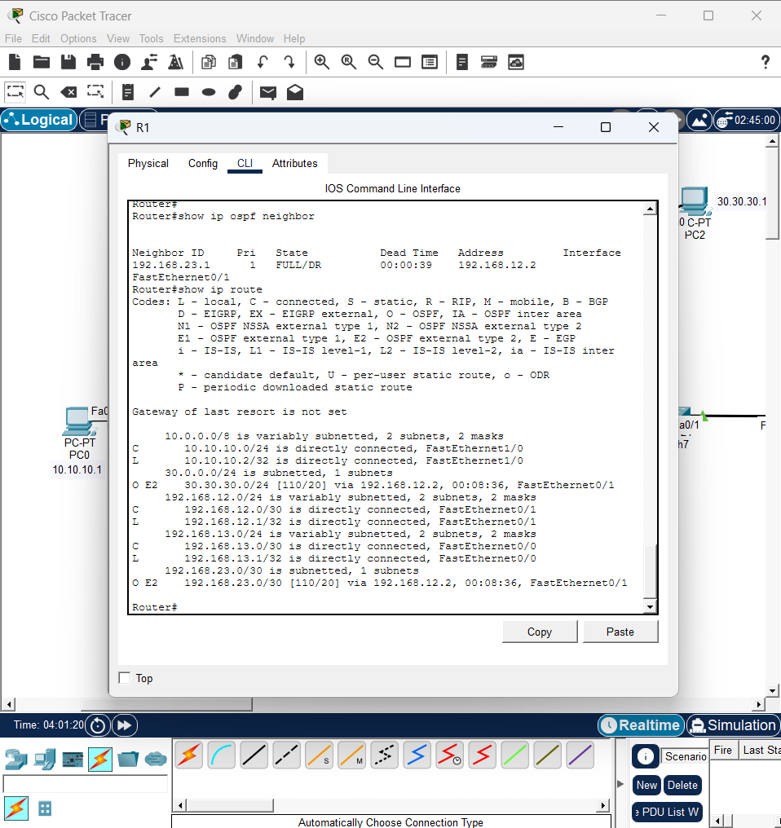
Missing Network Statement

Slide 8
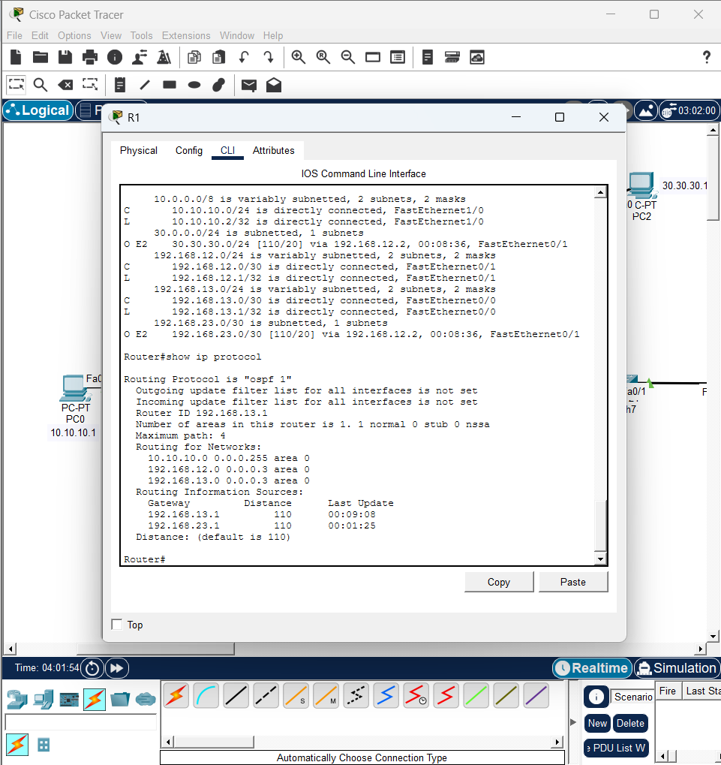
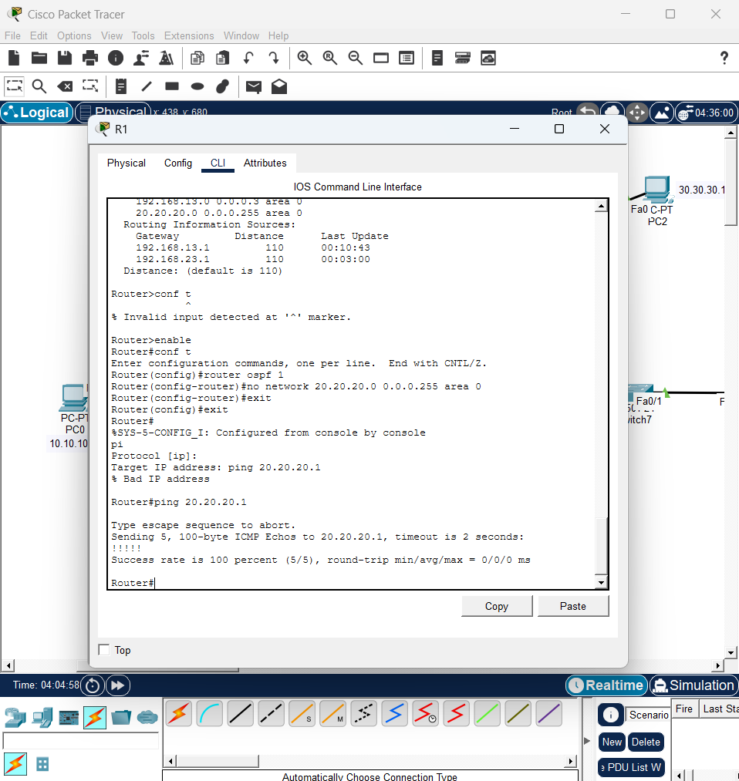
Missing Network Statement

Slide 9
DELIVERABLES
Wrong Wildcard Mask
“Incorrect wildcard mask caused OSPF to not match the correct interface, preventing neighbor adjacency.”
Commands used : show ip protocol
Passive Interface
“Passive interface suppressed OSPF hello packets, preventing neighbor formation.”
Command used: show ip ospf neighbor
Wrong Autonomous System
“EIGRP adjacency failed due to Autonomous System mismatch.”
Command used: show ip eigrp neighbors, show ip protocol
Missing Network Statement
“Network was not advertised into OSPF due to missing network statement.”
Command used: show ip route, show ip protocol

